Slide 1
Group 6:
Xinlian Huang,
Lulu Zhu,
Jiahui Bi,
Bowen Lu
Instructor:
Prof. Rong Liu
Text Mining
on Consumer Complaints
in Financial Products

Slide 2


Introduction
CFPB: Consumer Financial Protection Bureau
Motivation:
Online feedback
Diversified financial products and issues
Text automatic classification
Improve customer experience
Provide insights into business management
Notes:
By submitting a complaint, consumers can be heard by financial companies, get help with their own issues, and help others avoid similar ones. Every complaint provides insight into problems that people are experiencing, helping us identify inappropriate practices and allowing us to stop them before they become major issues. The result: better outcomes for consumers, and a better financial marketplace for everyone.

Slide 3
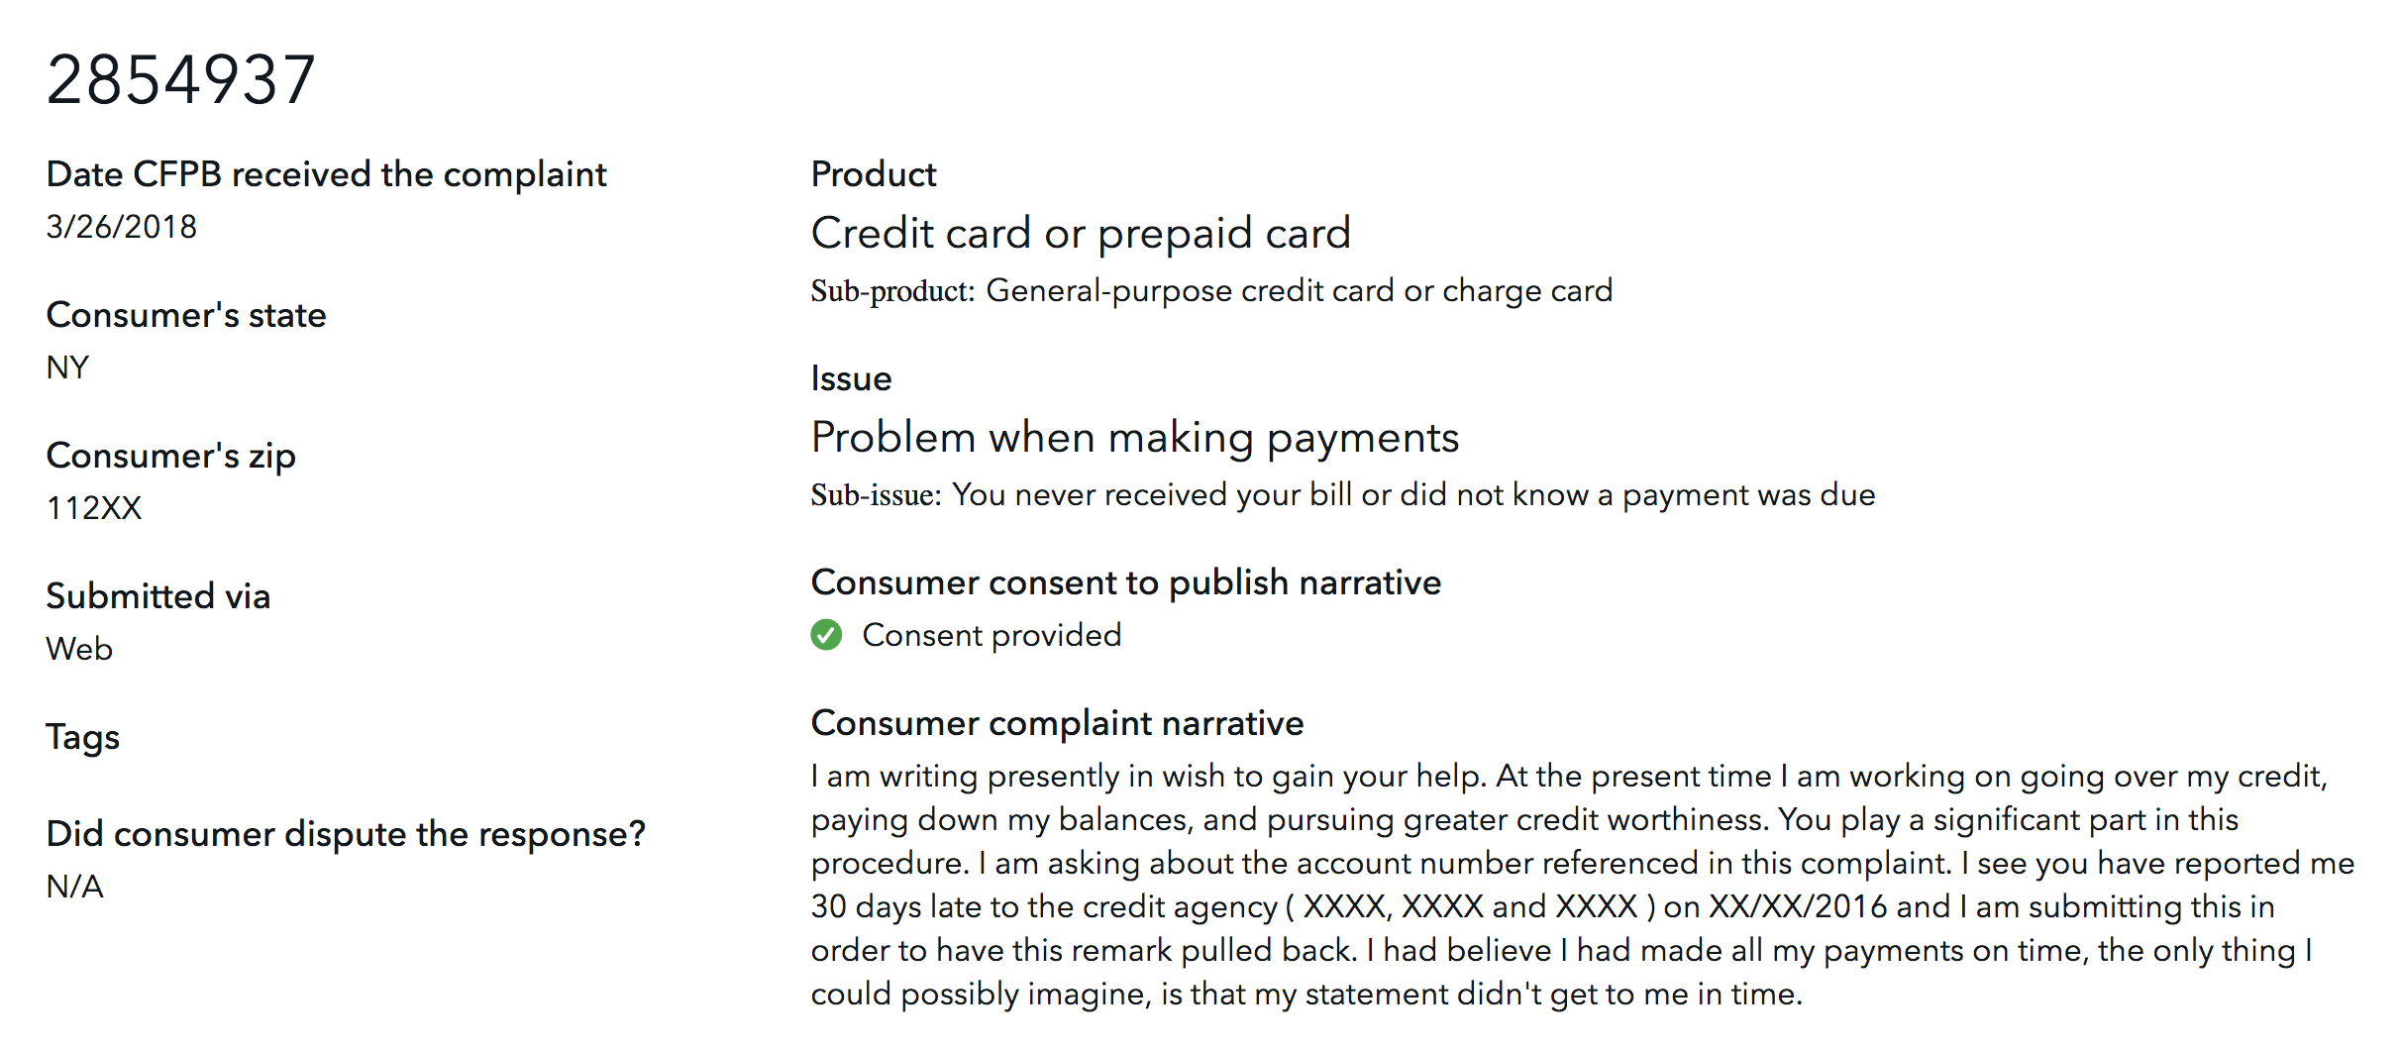

Complaint Sample

Slide 4
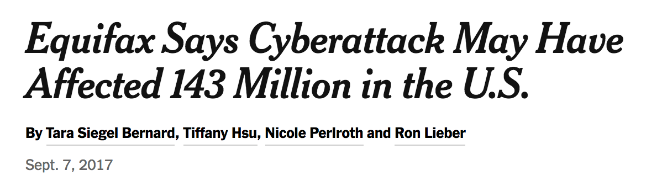
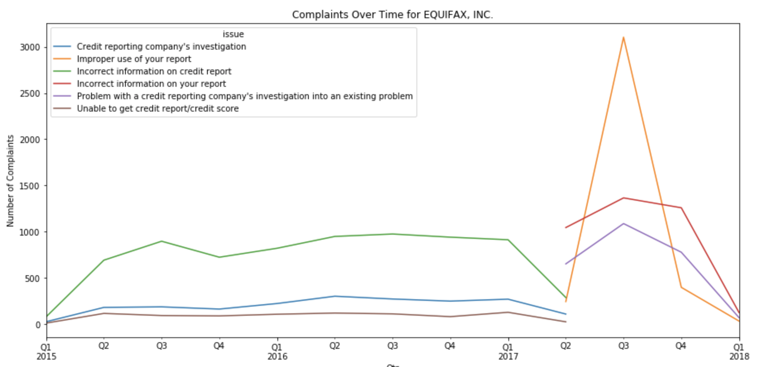
Timeline

Slide 5

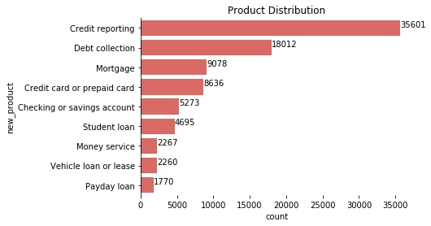
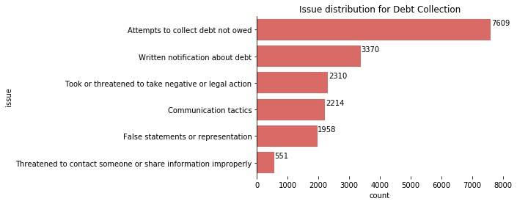
Preprocessing
('Debt collection', 'Attempts to collect debt not owed')

Slide 6
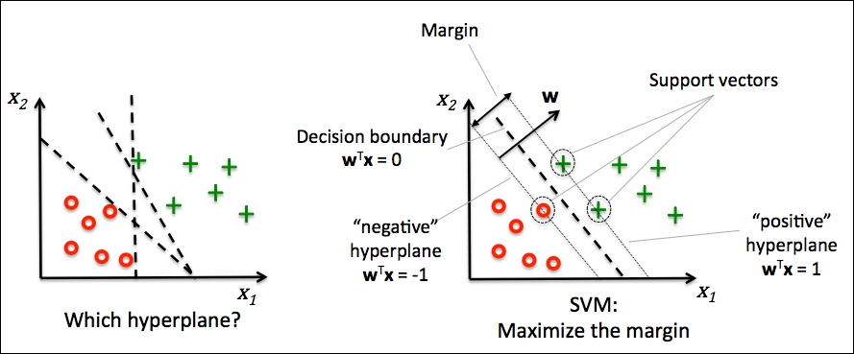
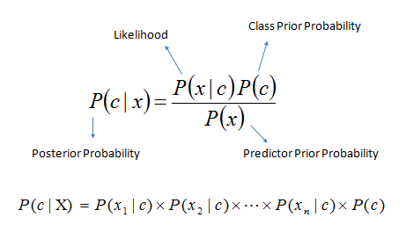
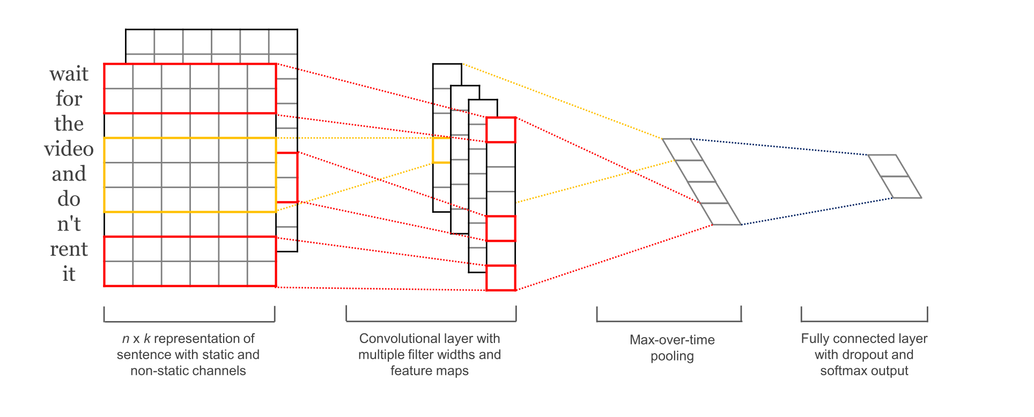
Modeling
SVM
Naive Bayes
CNNtext

Slide 7
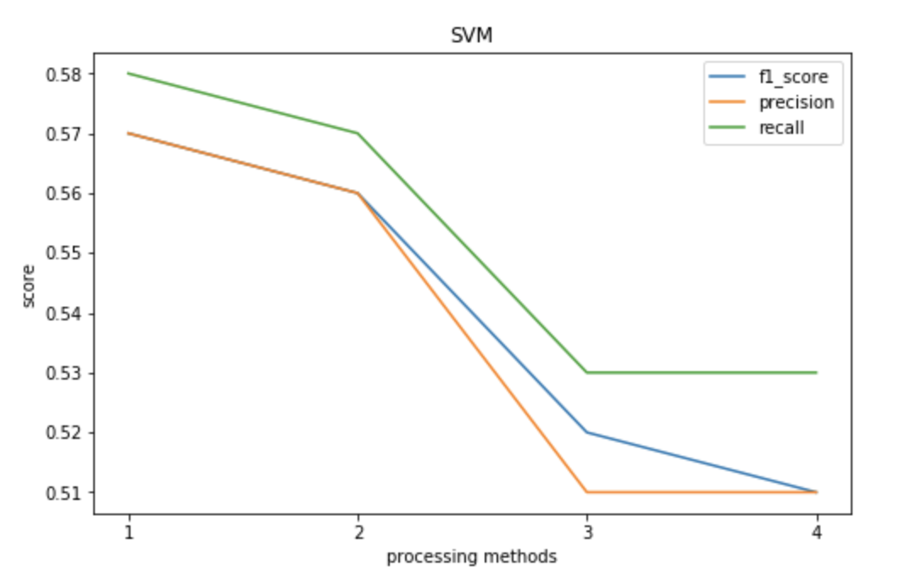
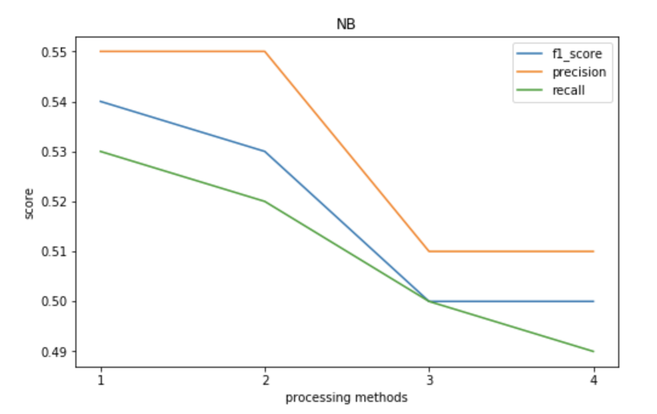
Pre-processing Comparison
1 -- only tokenize and vectorize
2 -- tokenize and vectorize + remove stopwords
3 -- tokenize and vectorize + remove stopwords + remove non-english words
4 -- tokenize and vectorize + remove stopwords + remove non-english words + stem
Notes:
Precision 高 => 预测出来的大部分都是对的，但是没有把全部的预测出来，recall => 样本中的正例有多少被预测正确了
f-score ： svm > NB, because NB has the independence assumption, but SVM take the interaction in to consideration
Why one has higher precision, another one has higher recall?

Slide 8
Embedding Comparison
Word Vector Weight | No pre-trained weight | Pre-trained weight + not trainable | Pre-trained weight + trainable
val_accuracy | 0.5744 | 0.5649 | 0.5780
No pre-trained weight: train the word vector from all 0.
Pre-trained weight + not trainable: use pre-trained word vector from GloVe, not changeable in the training process.
Pre-trained weight + trainable: use word vector from Glove, but the weight can change during the training process.
Notes:
Pre-train: save computing source
Trainable: make the word vector more suitable for our dataset

Slide 9
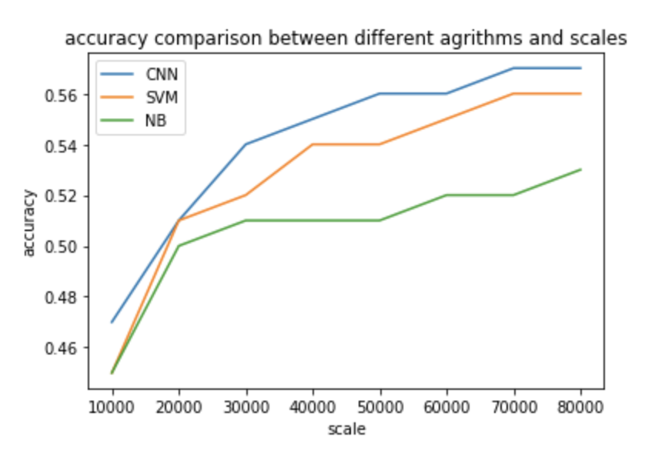
Dataset Scale Impact
Dataset scale changes from 10,000 to 80,000
Overall, accuracy of three models all raises with scales increases
CNN still has the highest accuracy

Slide 10
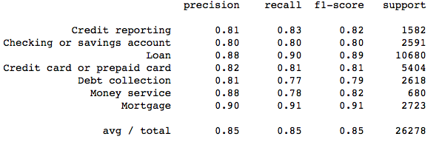
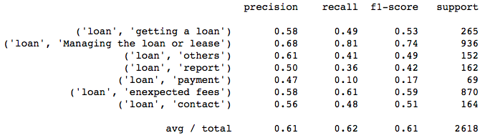
Two-step Classifier
Step 1: Predict the product type
Step 2:
Within the product, predict the issue

Slide 11

Vulnerability Analysis
Within the classification report, some categories are predicted very well
However, some labels all predicted incorrectly

Slide 12
Vulnerability Analysis
Pattern Recognition:
Among three models, “('Money transfer, virtual currency, or money service', 'service') all classified incorrectly. ”
Reason explanation: Money transfer issue must relate to bank account
2. In Naive Bayes, most label which classified incorrectly are “others”.
E.g.: ('Mortgage', 'others'), ('Checking or savings account', 'others')
Reason explanation: Narratives contain too many information and cross several topics

Slide 13
Further Improvement
Dimension Reduction: Truncated SVD
A variant of Singular Value Decomposition (only compute K nearest SVs)
Transform large scipy.sparse matrices (e.g. tf-idf) to low dimension feature spaces
Difference with PCA: use sample matrices instead of covariance matrices
Gradient Boosting Decision Trees
Boosting: add new models to reduce the residuals/errors of prior models until
no further improvement made
Gradient boosting: gradient descent algorithms to minimize the loss
popular algorithms:
XGBoost (depth-wise splitting) LightGBM (leaf-wise splitting)
CatBoost (works well with categorical variables)

Slide 14



Business value
Decrease risk of throwing complaints into wrong issues
Save time for manual selection of products and issues
Discover correlations between different products/issues
Predict troublesome products/issues in the future
Adjust the category of products and issues
Introduce multilabel to enhance the classification accuracy
Change submission: products + narrative → issue matched

Slide 15
Thank You
Questions?

